Slide 1
Soft Gold The history of Russians in Alaska

Slide 2
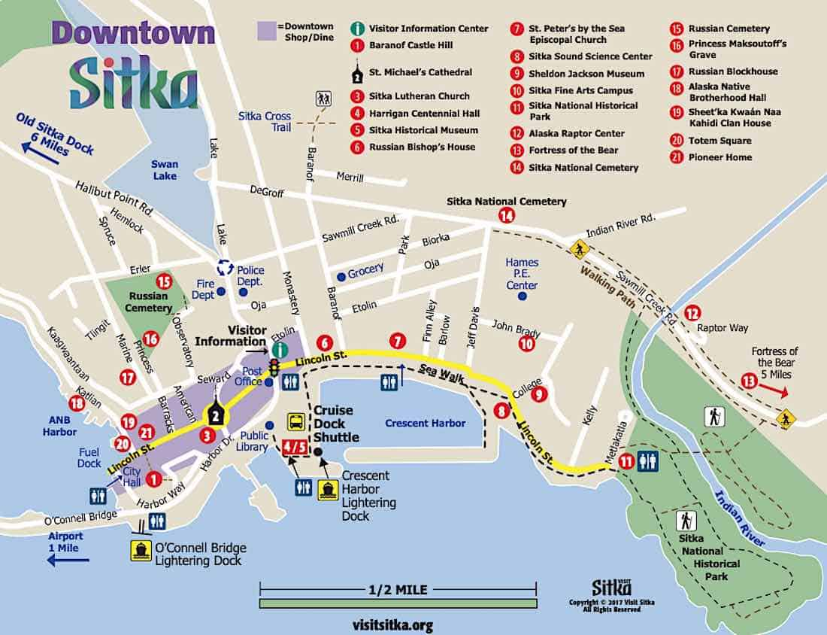
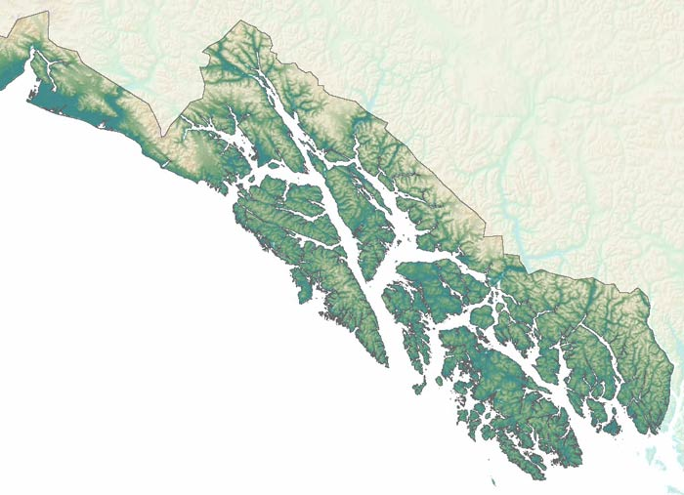

Slide 3
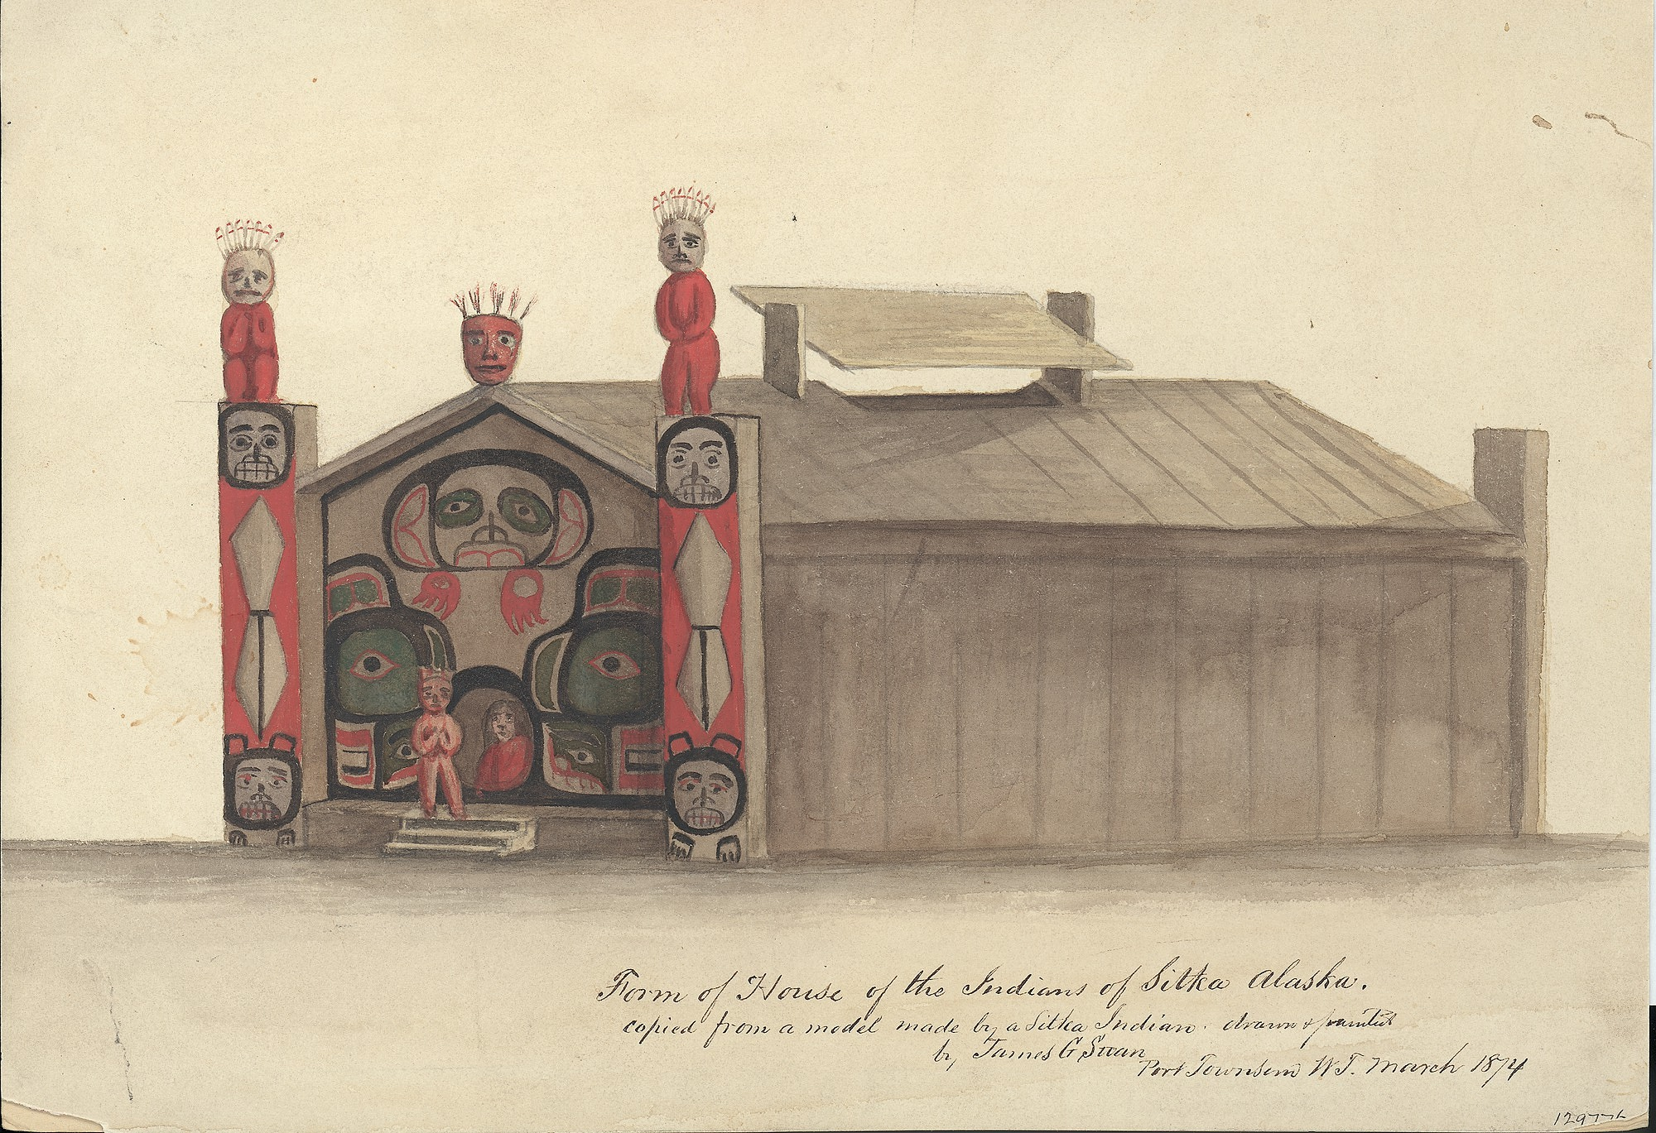
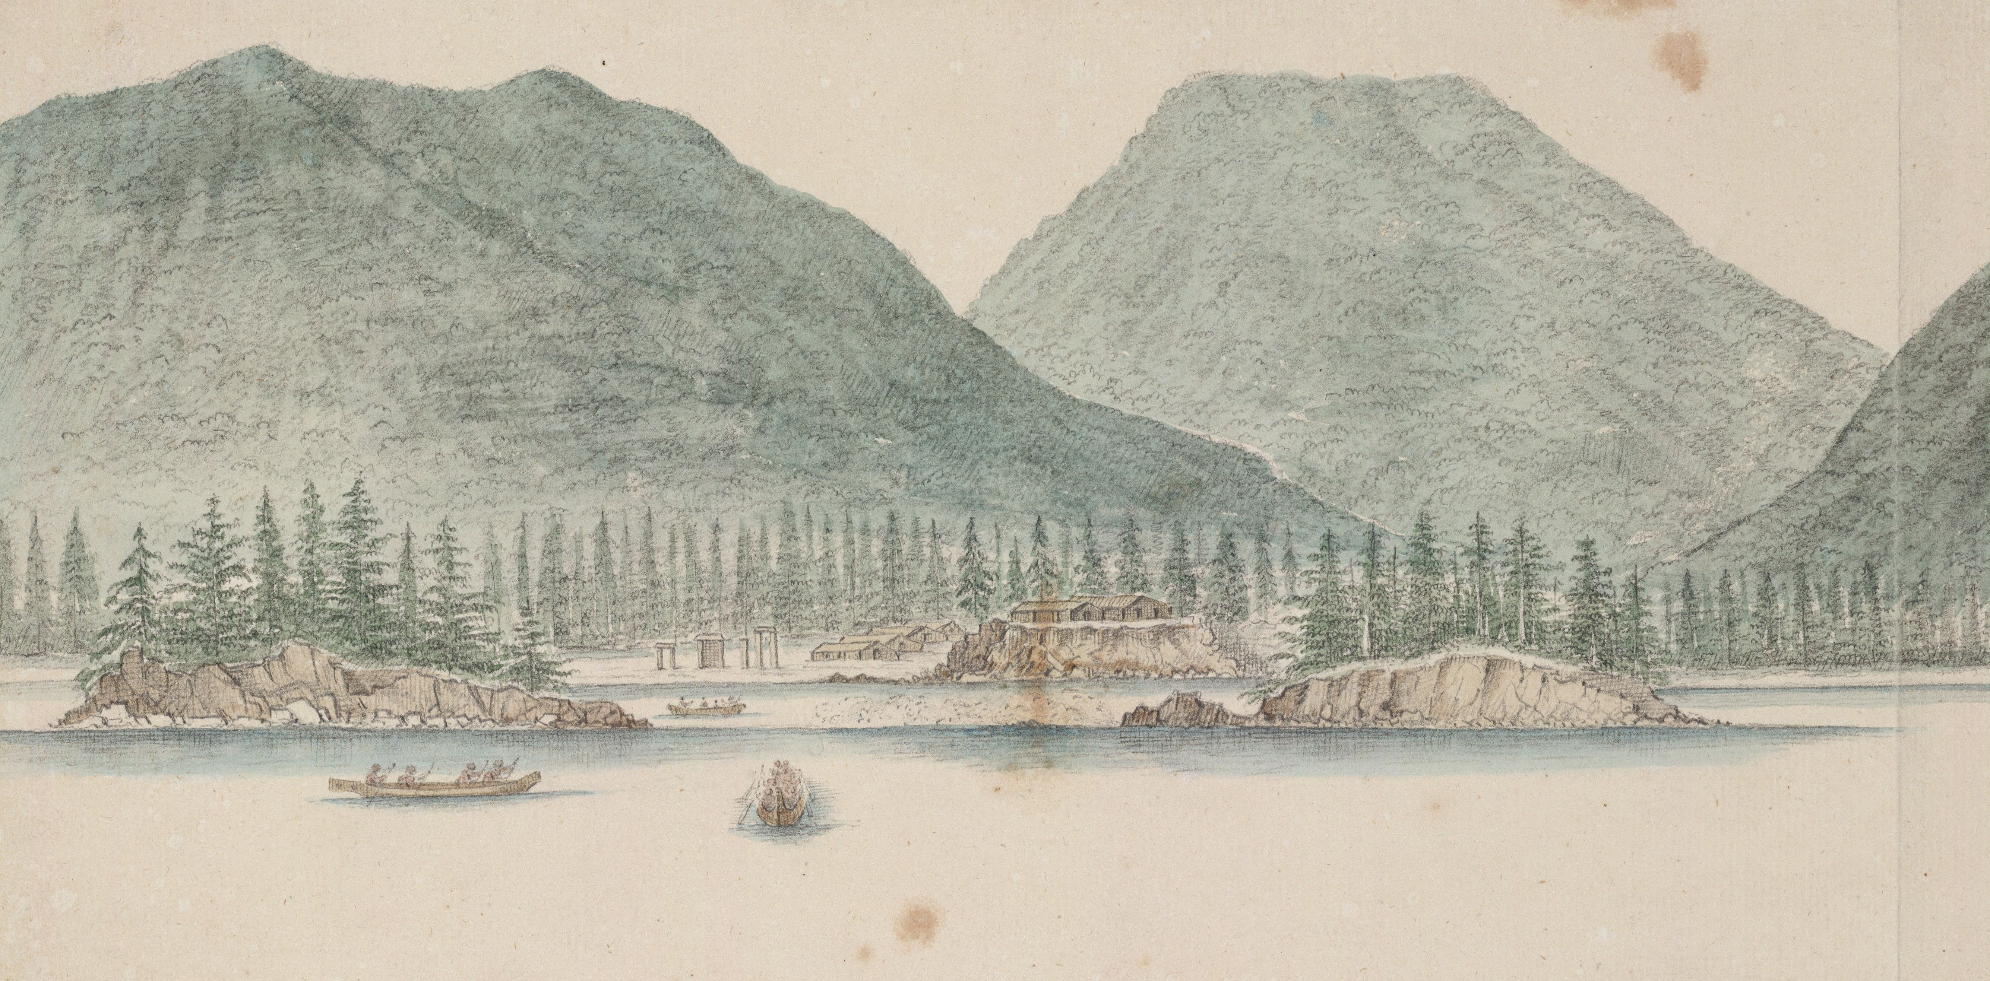
Tlingit
Regalia
Special clothing and accessories worn during gatherings and ceremonies

Slide 4
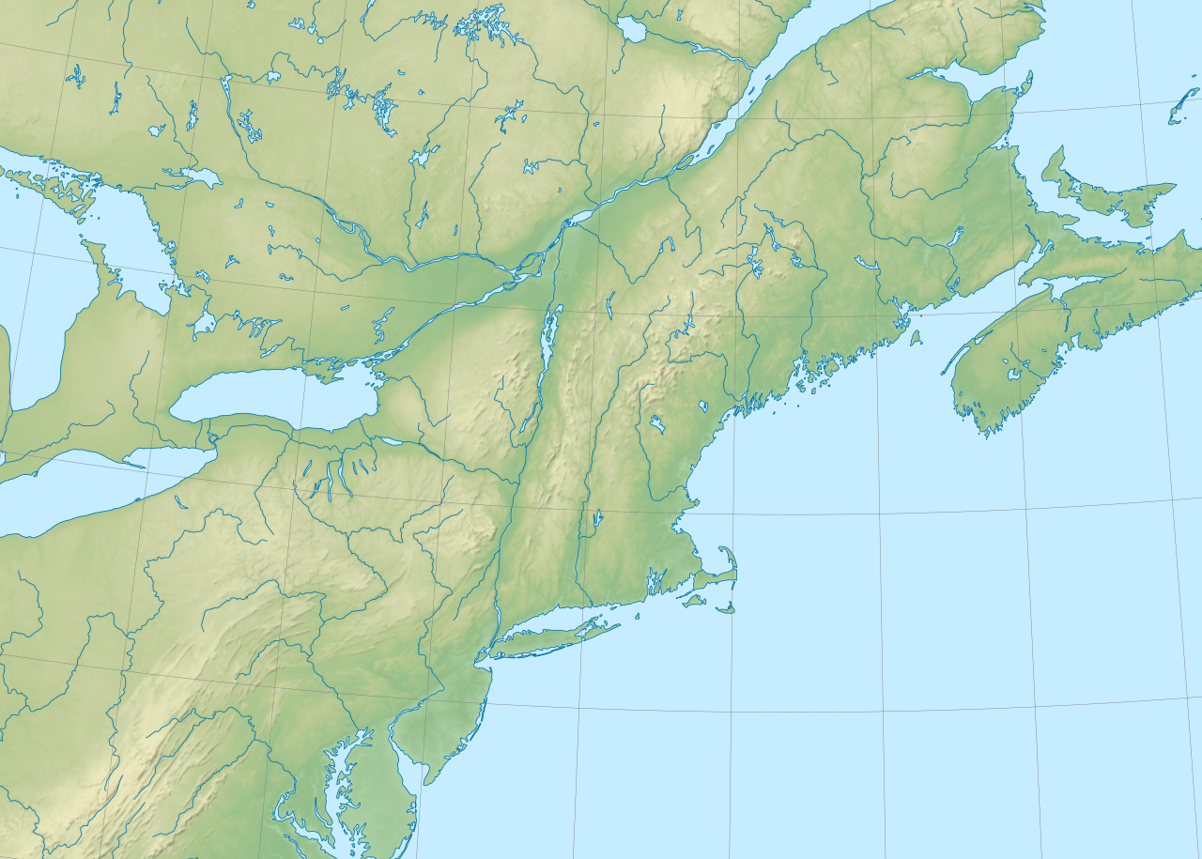
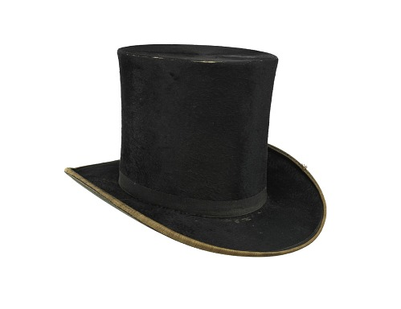
Canada
What do you think the most popular thing to make out of beaver fur was?
Coats
Hats
Pants
Shoes
Bags
New England
Atlantic Ocean

Slide 5
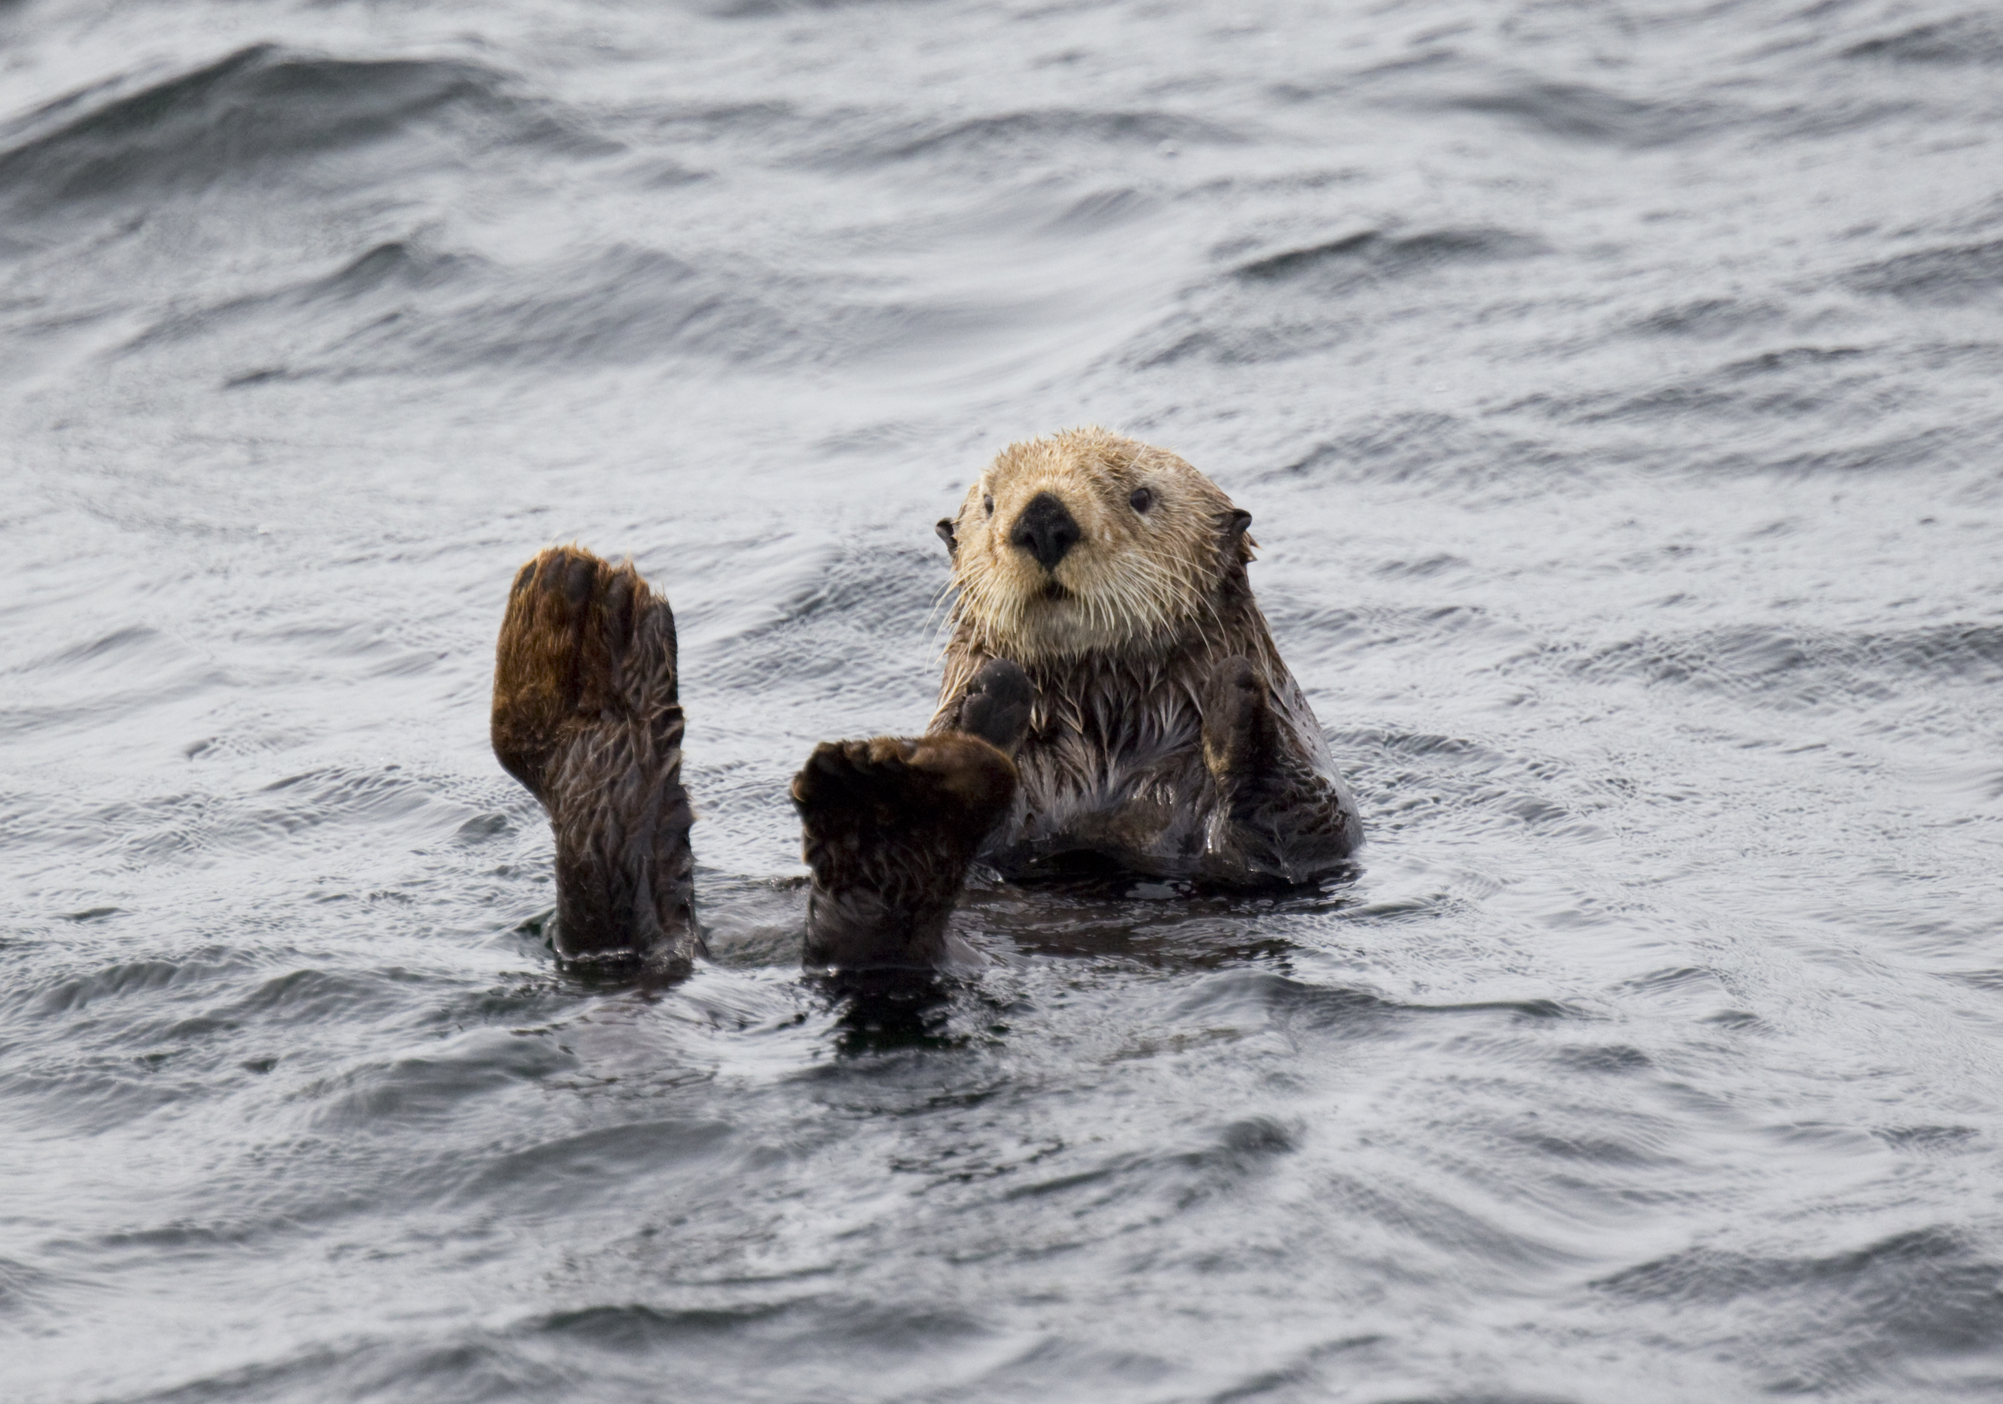
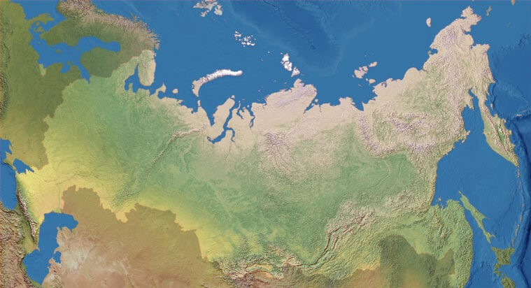
What kind of animal is this?
Sable
Wolverine
Marten
Siberia
Pacific Ocean

Slide 6
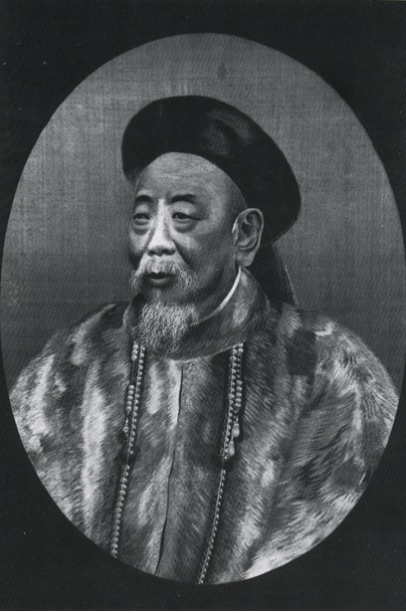
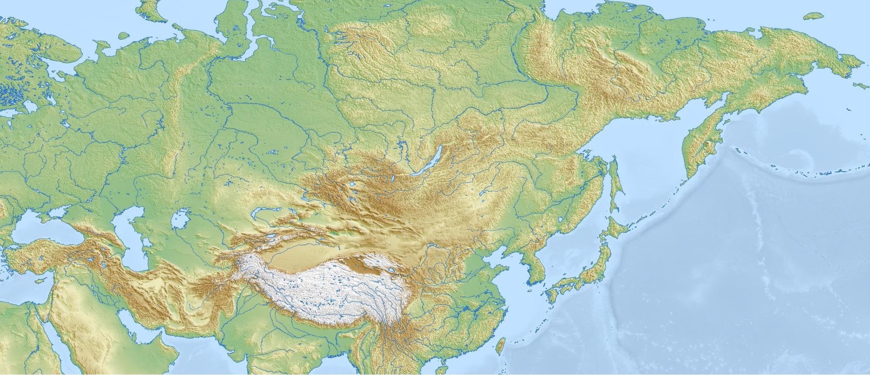
Which of the following are considered “luxury goods” today?
Groceries
Toothbrush
Car
Sunglasses
Hand Sanitizer
Laptop
S I B E R I A
What is a “Luxury Good”
Something that isn’t necessary to live but is seen as very valuable or highly desirable within a certain society or culture
Tea, Porcelain, and other trade goods
Sea Otter Fur
CHINA

Slide 7
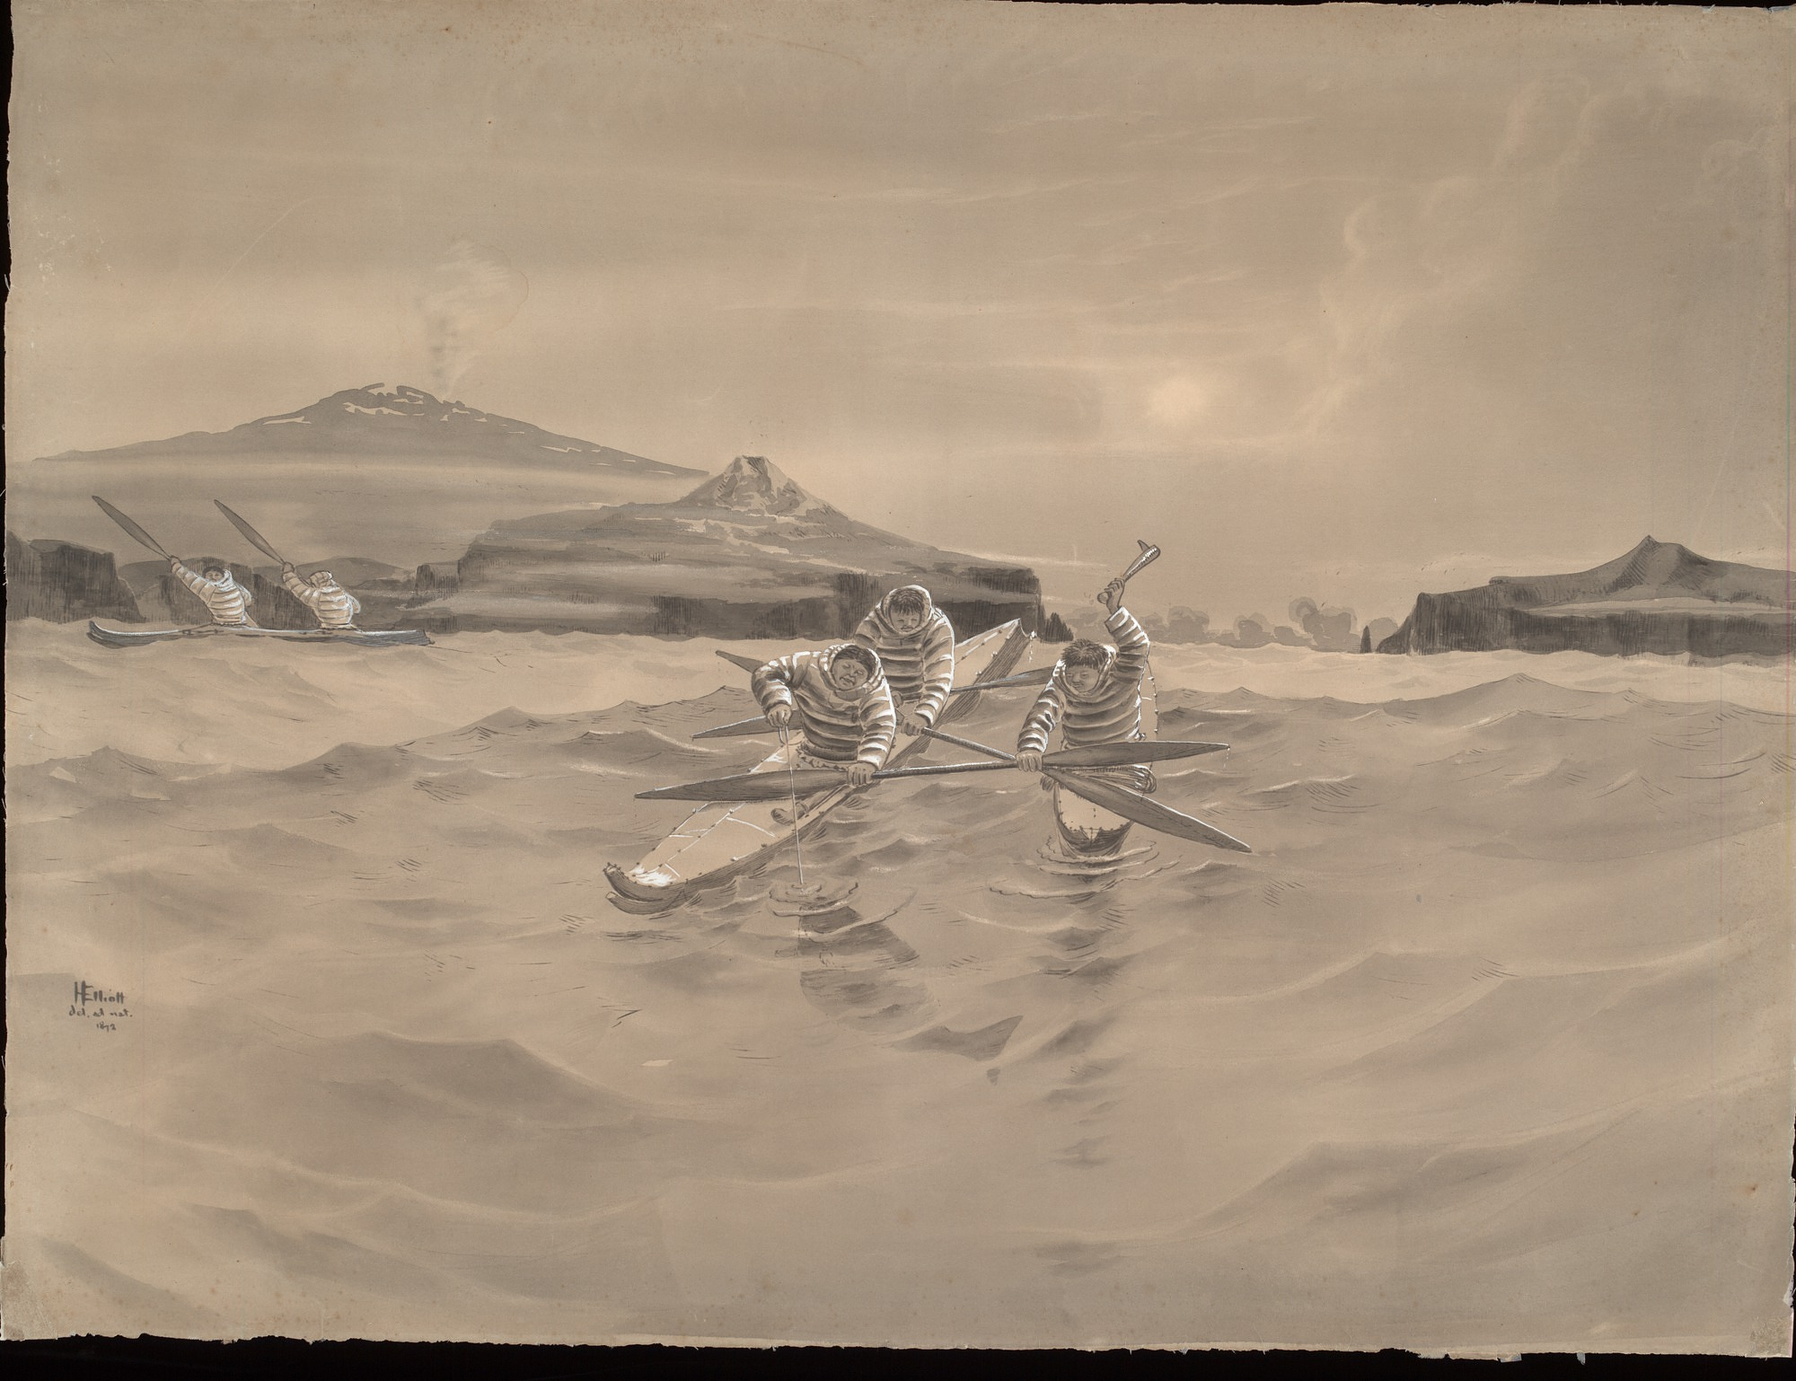
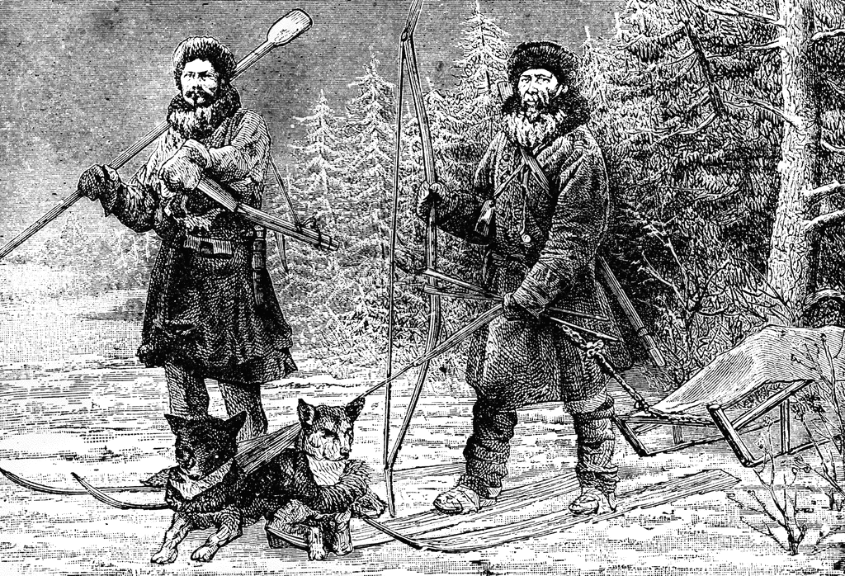
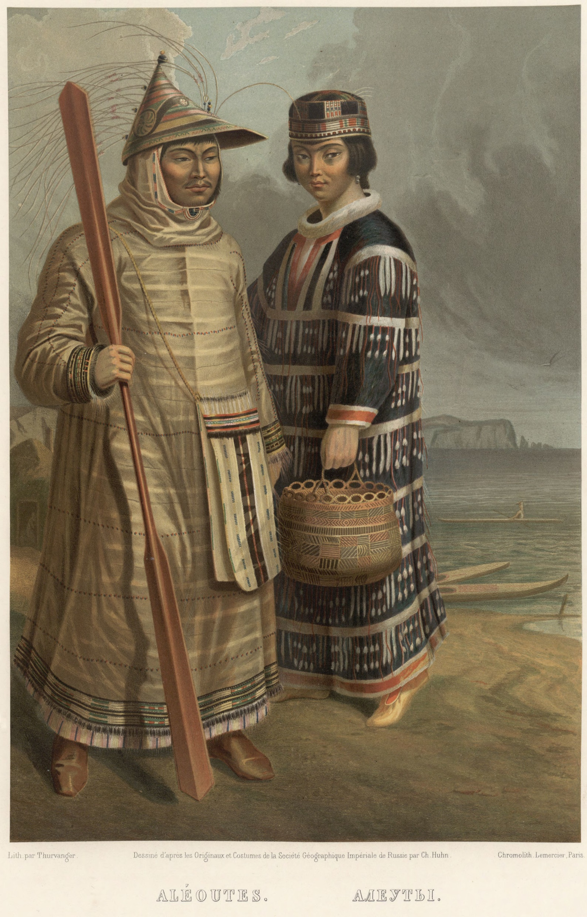
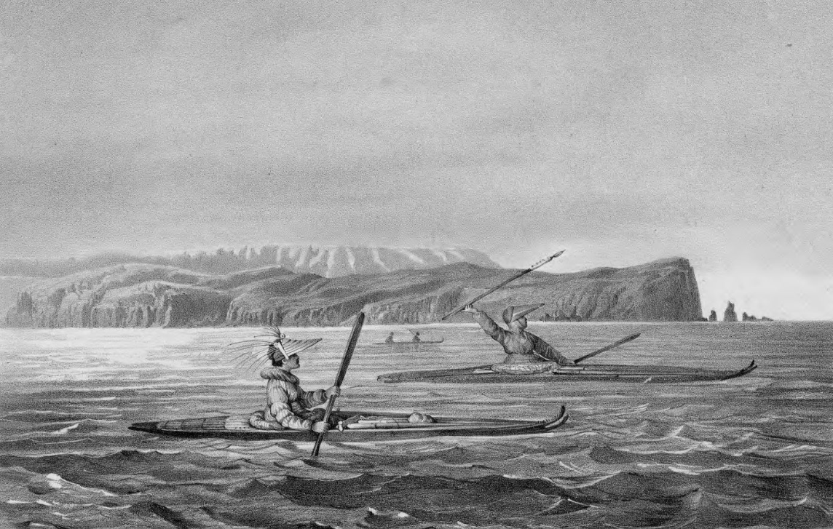
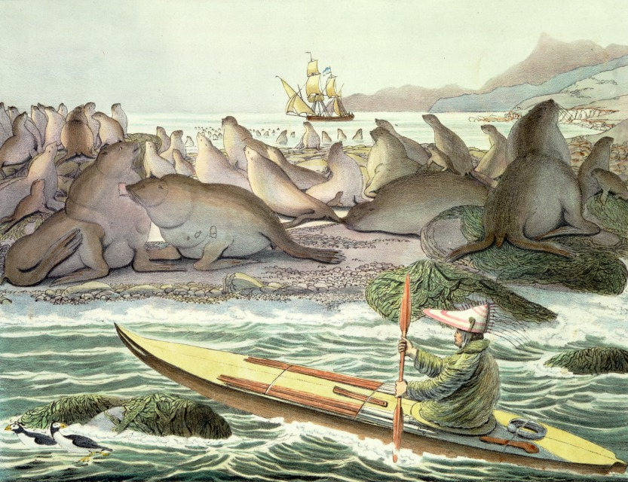
Aleut or Unangan
Coercion:
When people force others to do something they don’t want to, using threats or by hurting them.

Slide 8
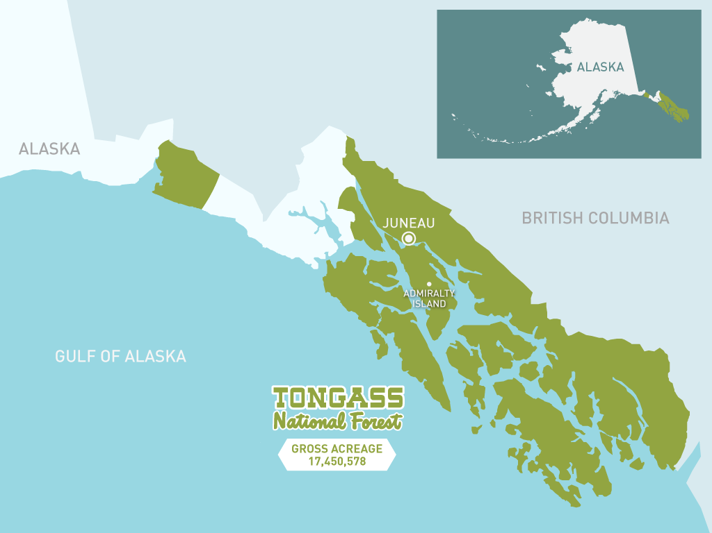
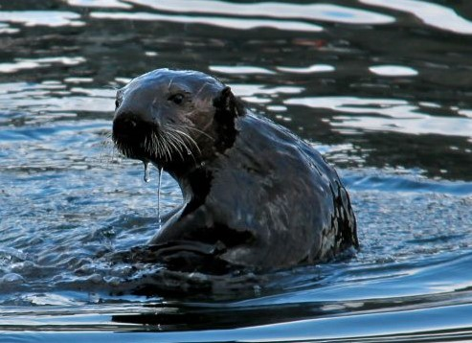
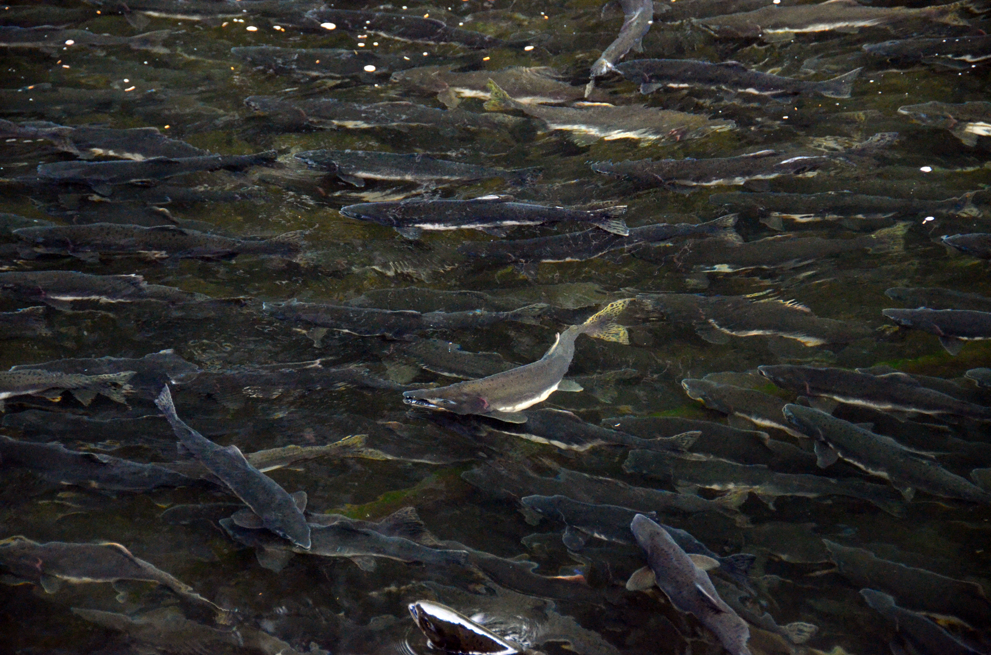
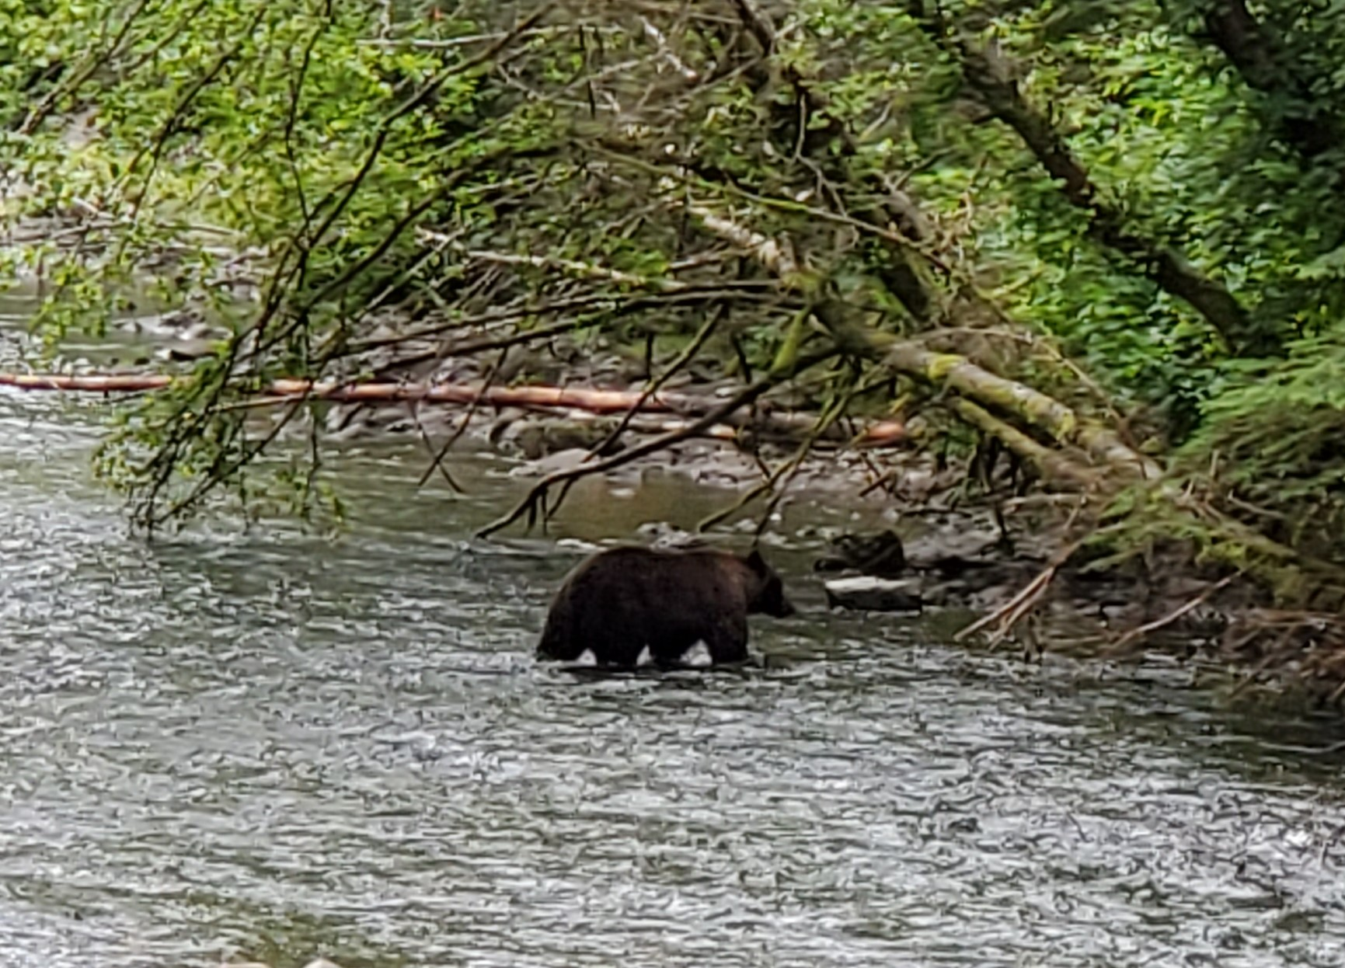
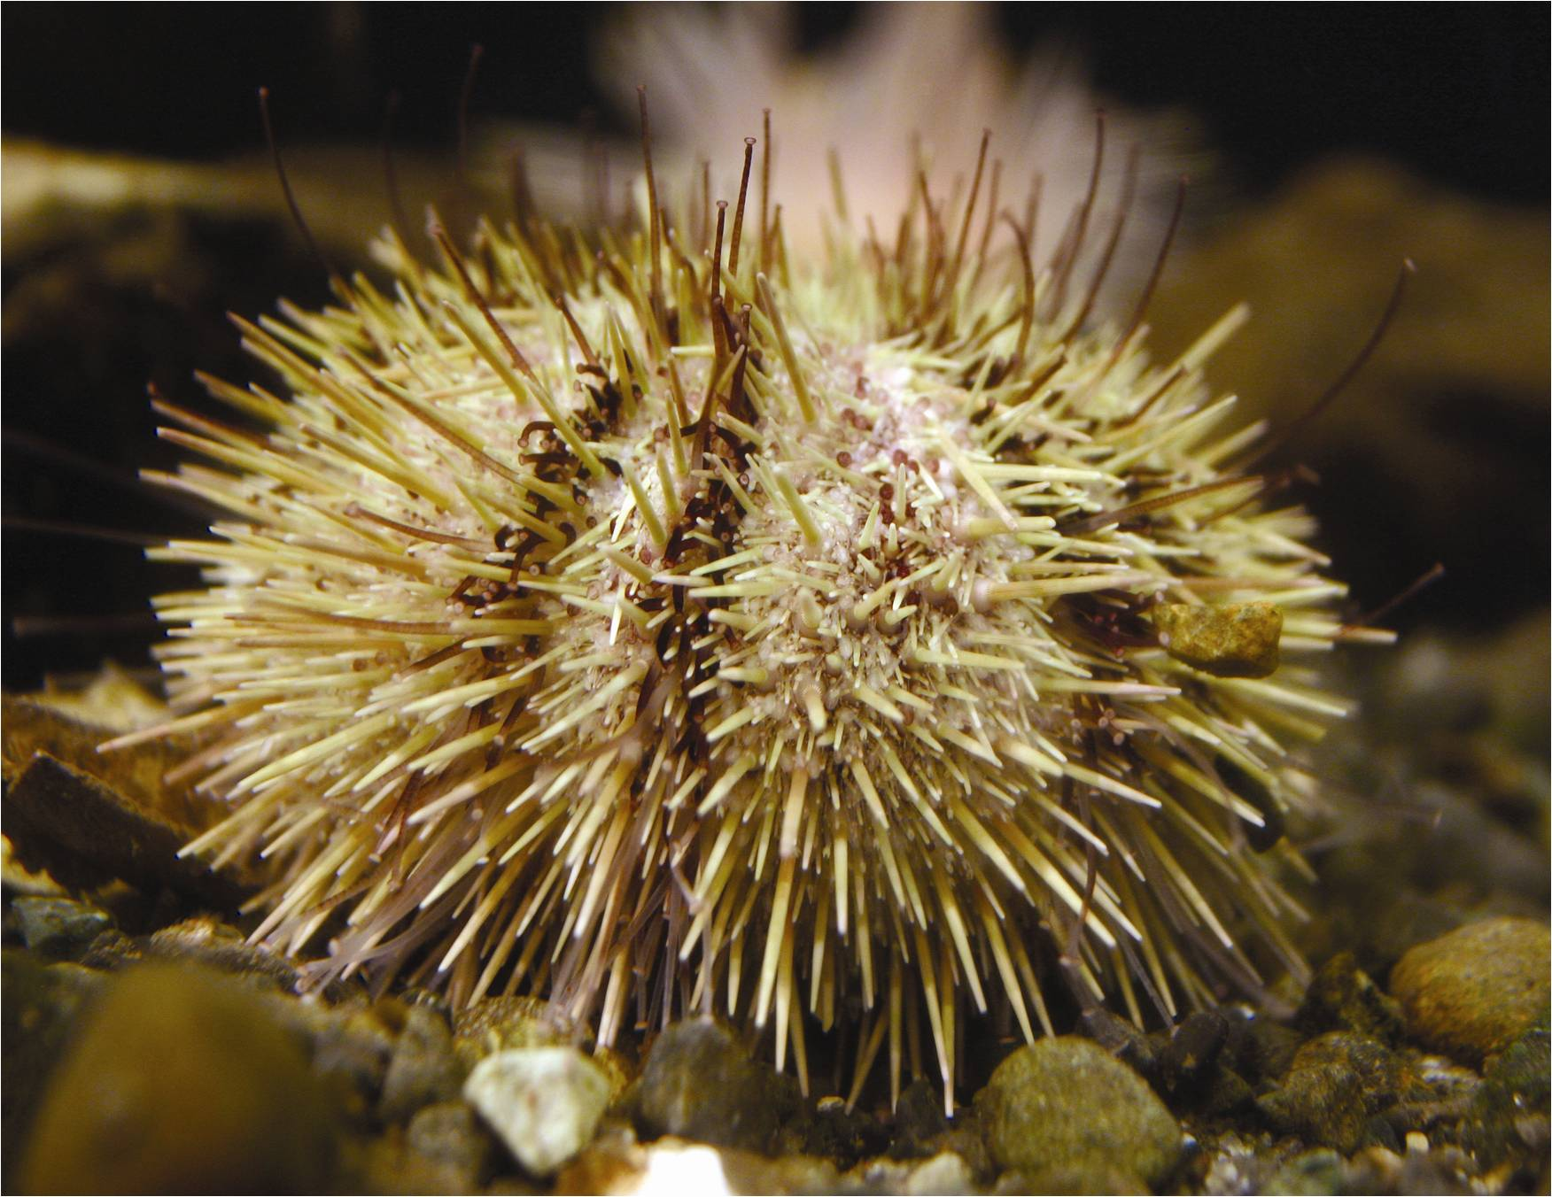
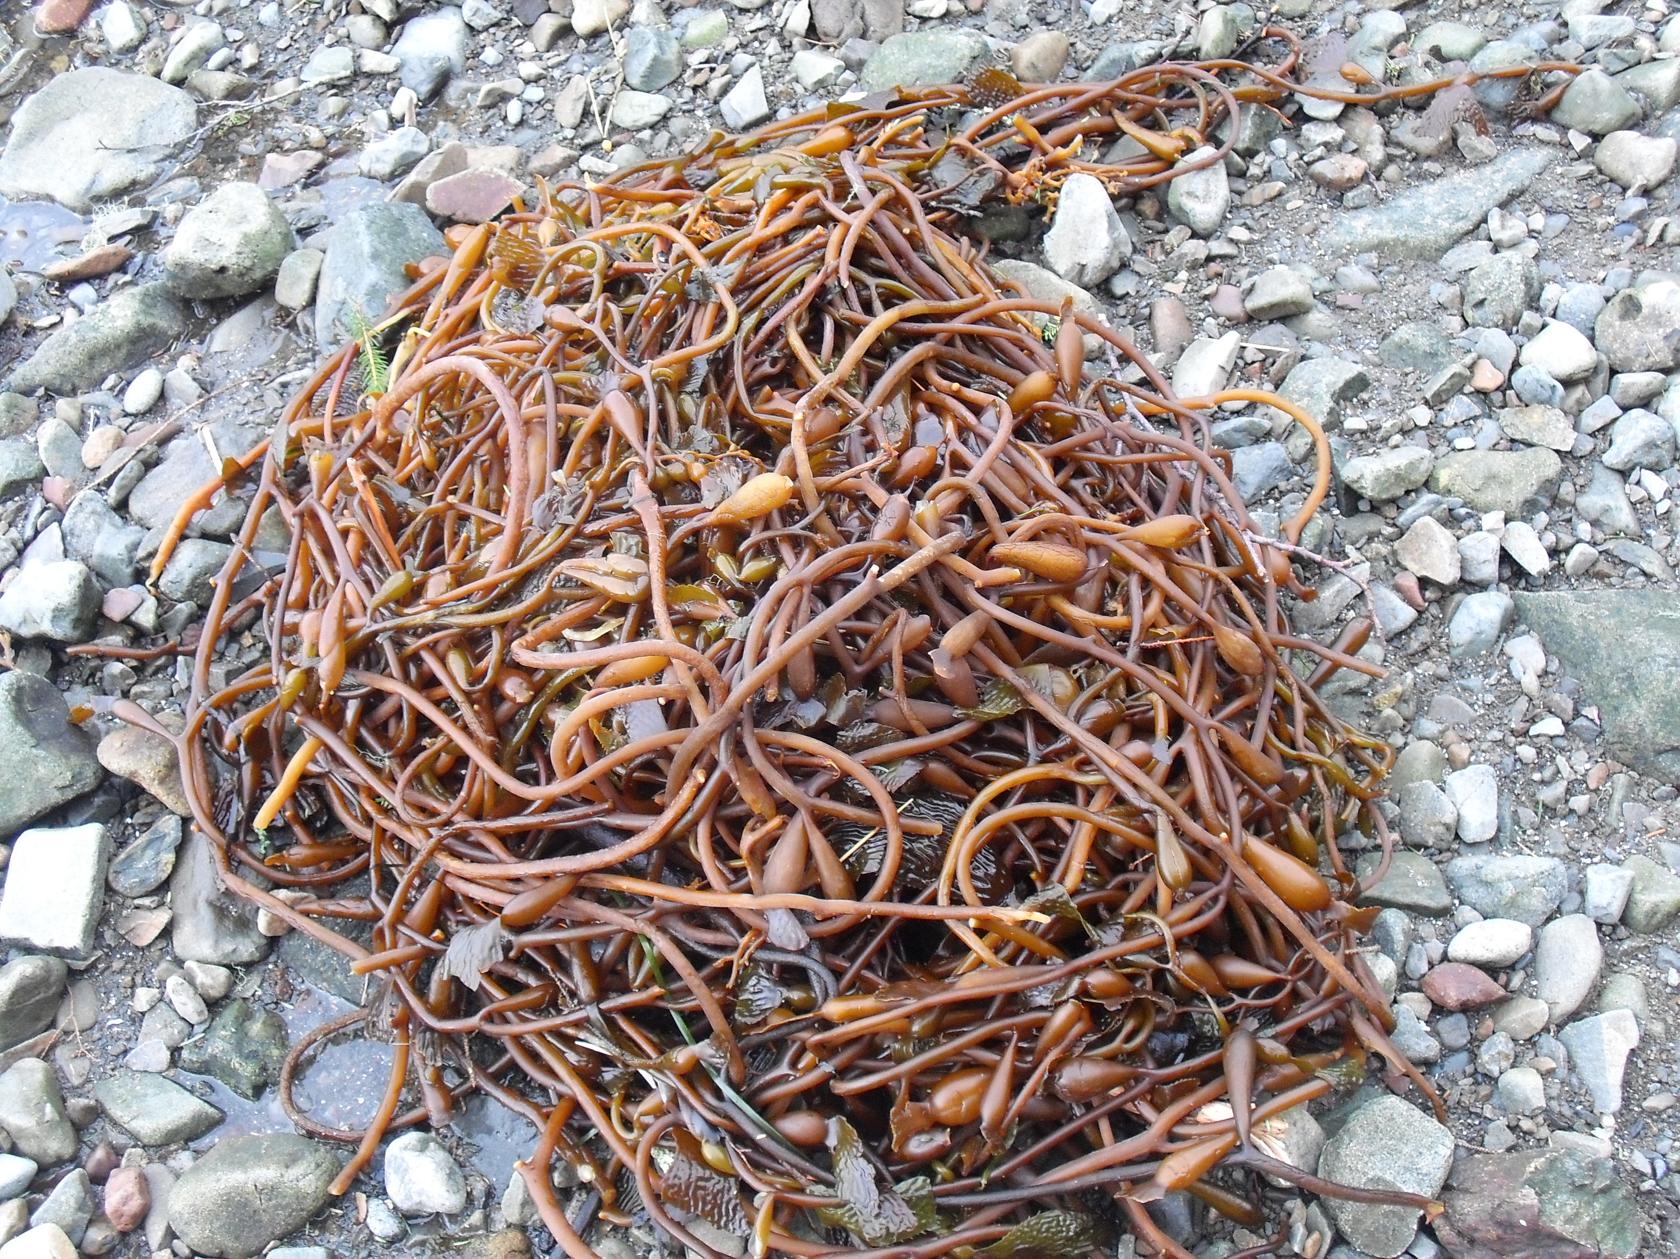
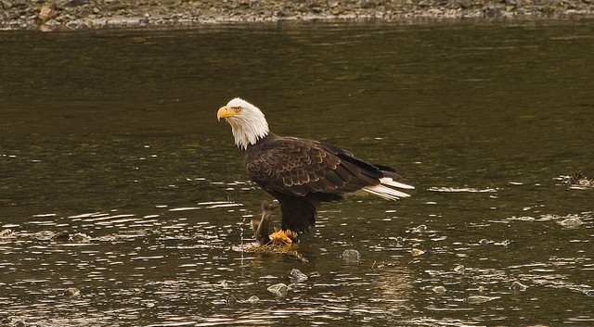
Keystone Species:
A species which has a big effect on the place it lives, more than others that it shares that place with
Habitat: A place where a plant or animal normally lives and grows
Subsistence:
Taking only what you need from the natural world, and no more

Slide 9
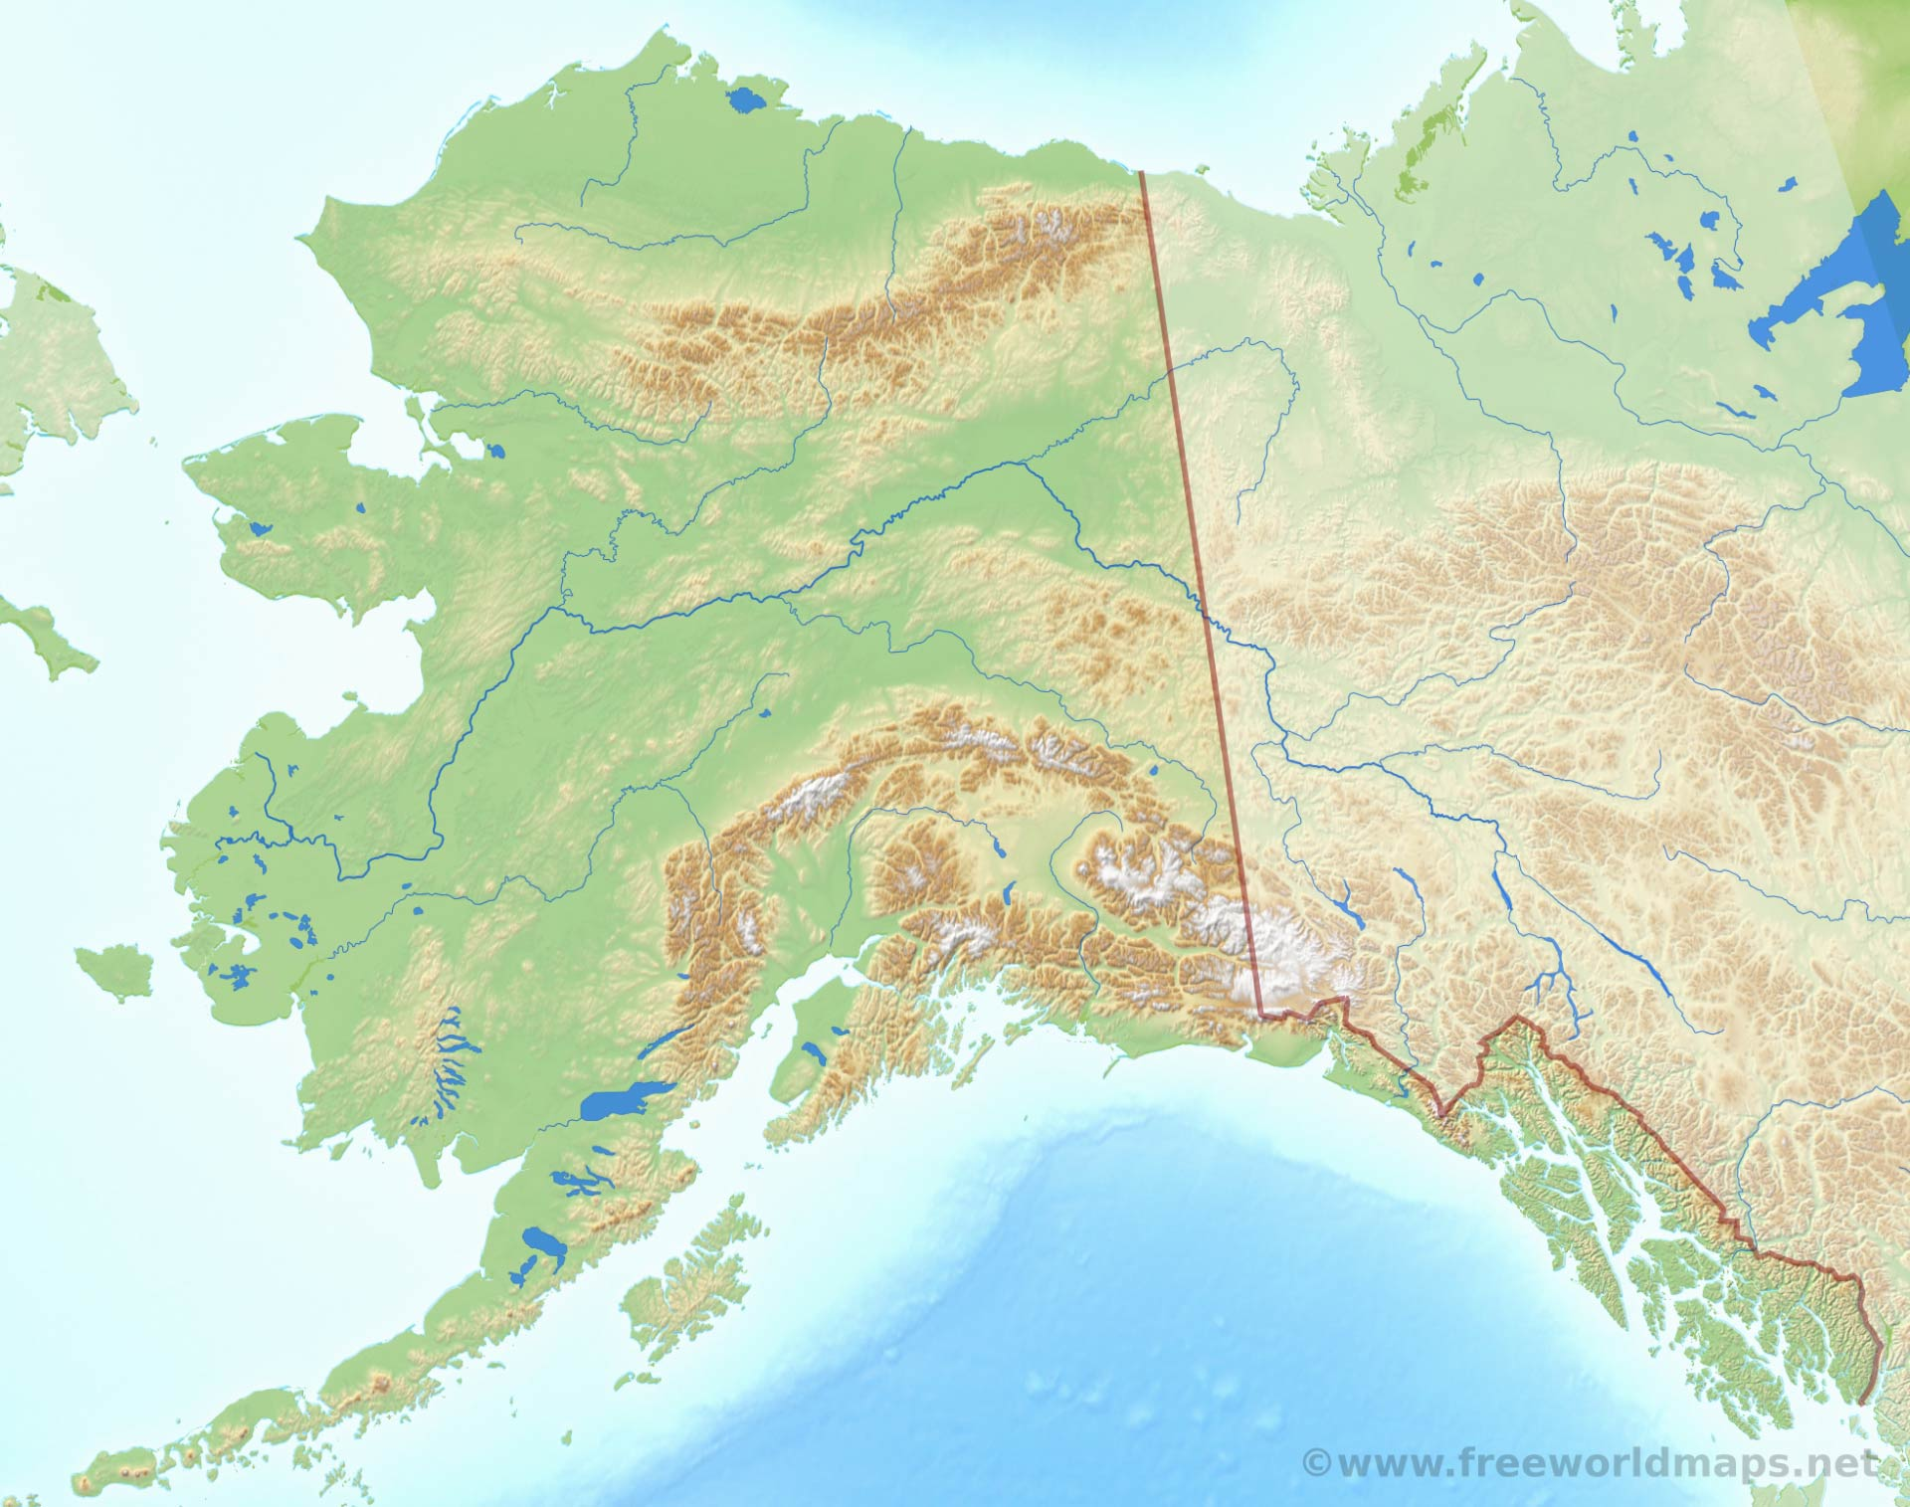
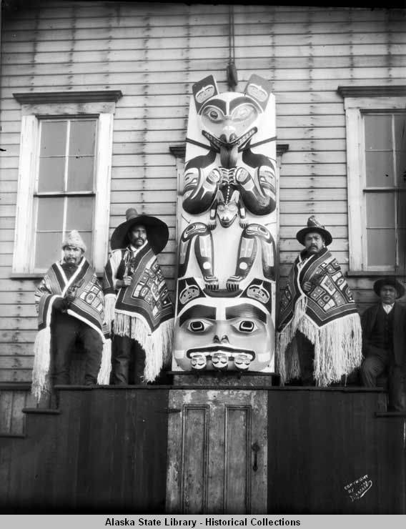
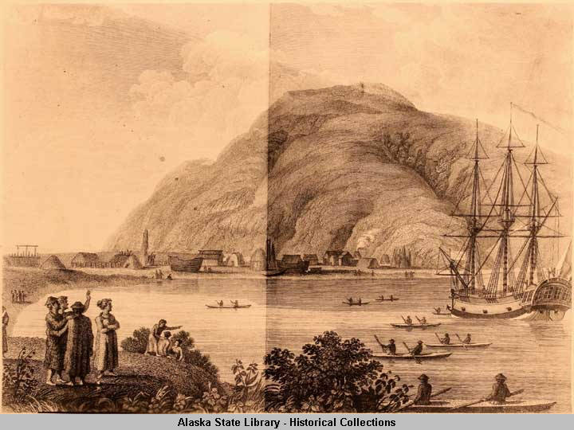
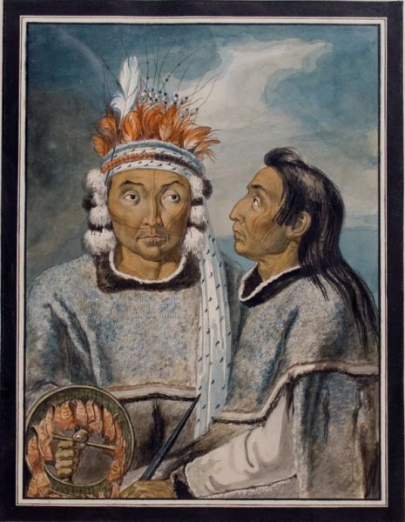
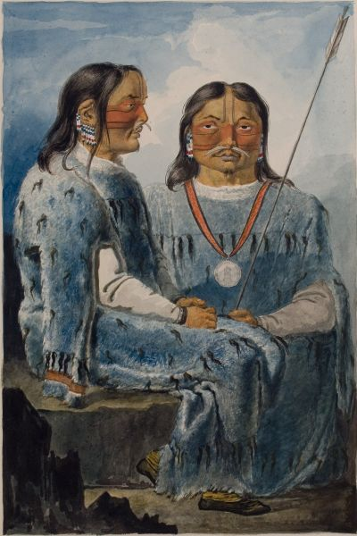
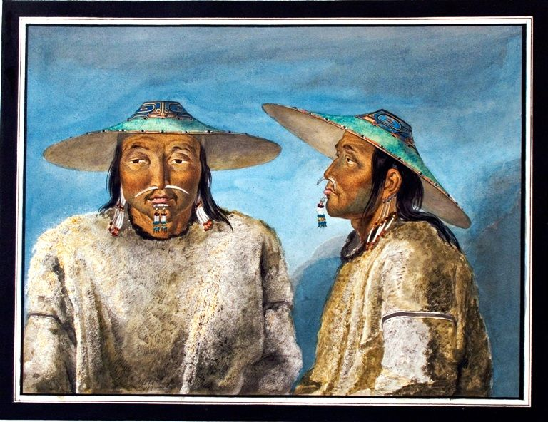
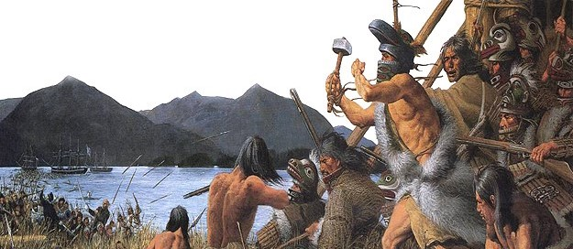
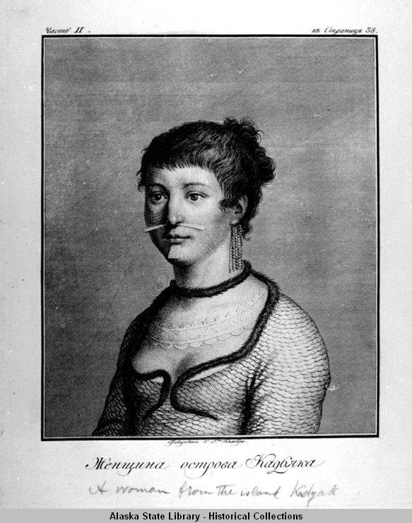
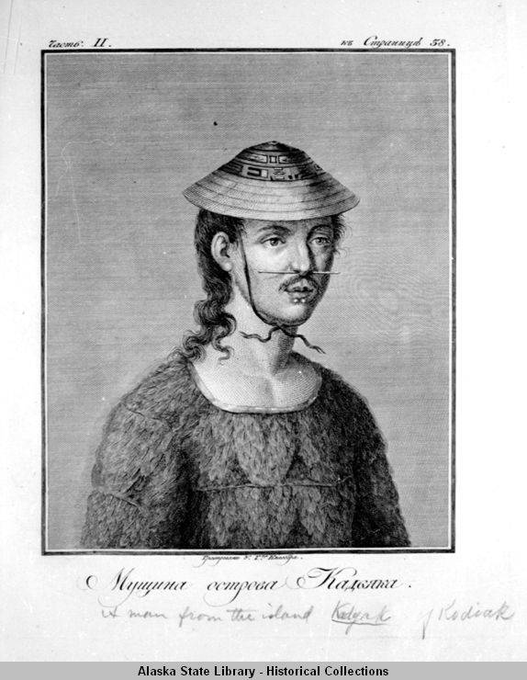
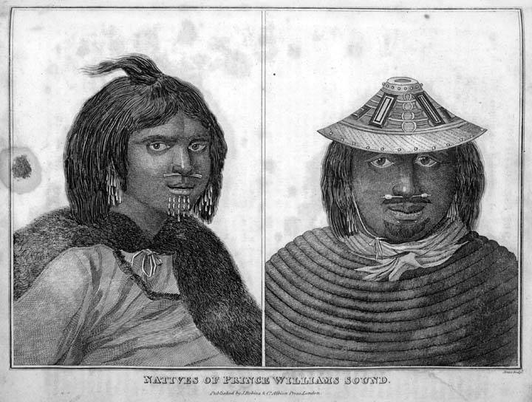
Sugpiaq or Alutiit

Slide 10
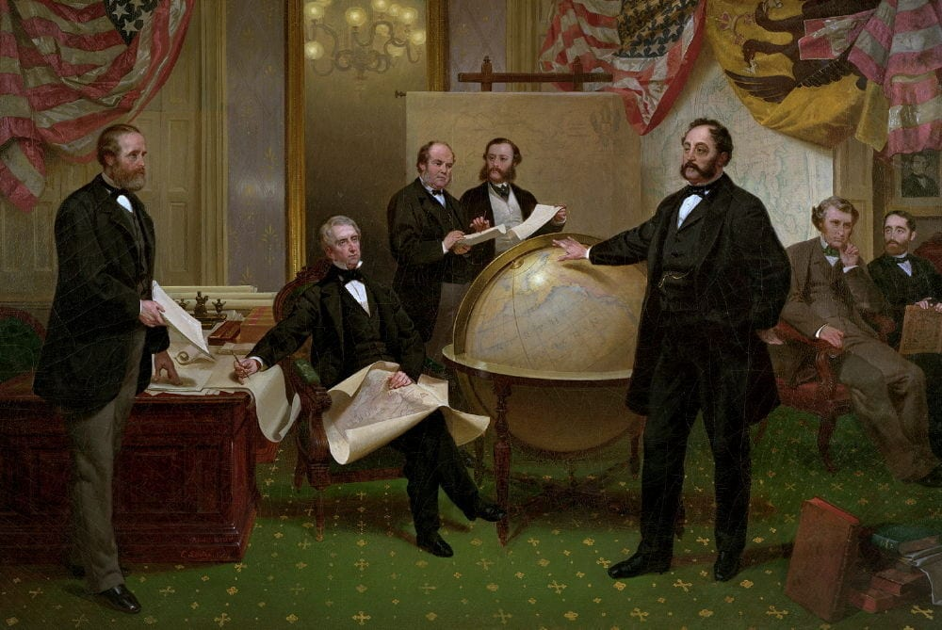
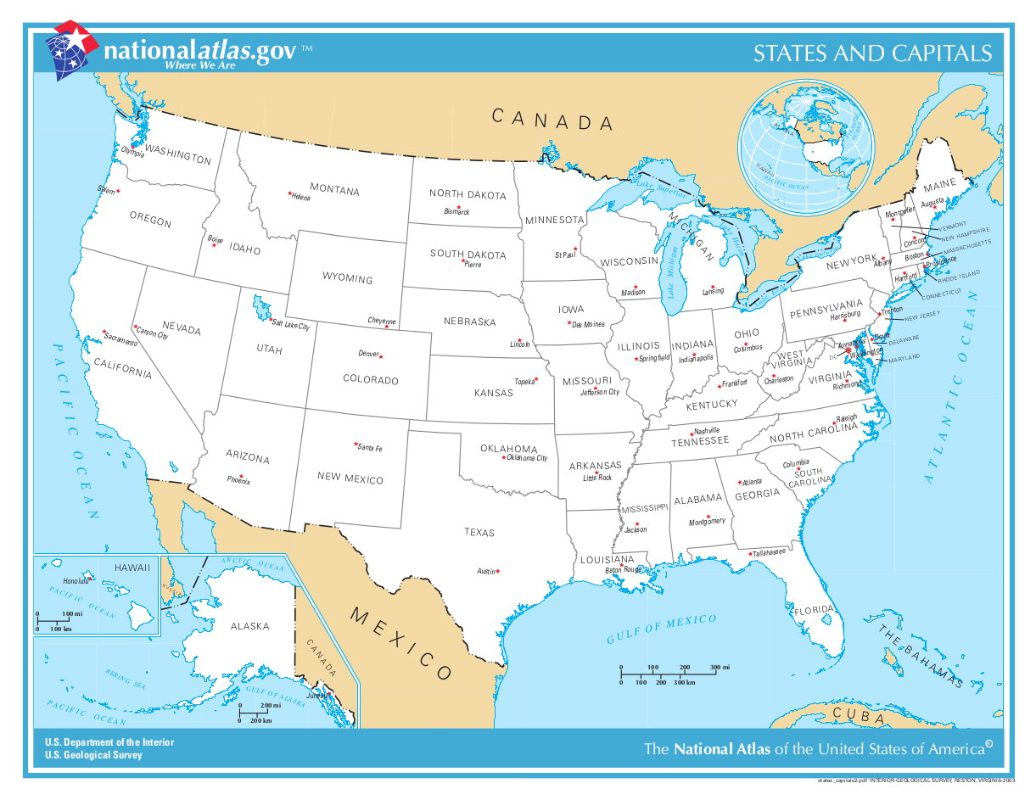
Ново Архангельск
“Novo”
“Novo Arhangelsk”
“Arhangelsk”
New Archangel
What is the Capital of the United States?
New York City
Boston
Washington DC
Chicago
San Francisco

